Slide 1
“The beauty of a woman is not in the clothes she wears, the figure that she carries, or the way she combs her hair. The beauty of a woman is seen in her eyes, because that is the doorway to her heart, the place where love resides. True beauty in a woman is reflected in her soul. It's the care that she lovingly gives, the passion that she shows and the beauty of a woman only grows with passing years.” –Audrey Hepburn

Slide 2
Does Participating In A Beauty Pageant Have A Positive Influence On Individuals?
Zeidy Jaen

Slide 3
How do participants of a beauty pageant grow individually?
Increasing self-esteem
Blossoming of communication skills
Overcoming fear of public speaking

Slide 4
How do participants of a beauty pageant grow socially?
Diverse friendships
Job connections

Slide 5
How does a community benefit from a beauty pageant?
Charity work
Tourism

Slide 6
Because I researched the positive influence of beauty pageants on individuals, I decided to teach classes on the importance of natural beauty as my product.

Slide 7
Product
Attended teaching information session
Met with leader of Women’s Department
Created lesson plan and began Prezi
Created pre- and post- class surveys

Slide 8
Product
Researched natural beauty tips
Created natural beauty brochure
Contacted mentor
Bought supplies and finished Prezi

Slide 9
Product
Taught first class
Emailed mentor
Taught second class
Met with leader of Women’s Department

Slide 10
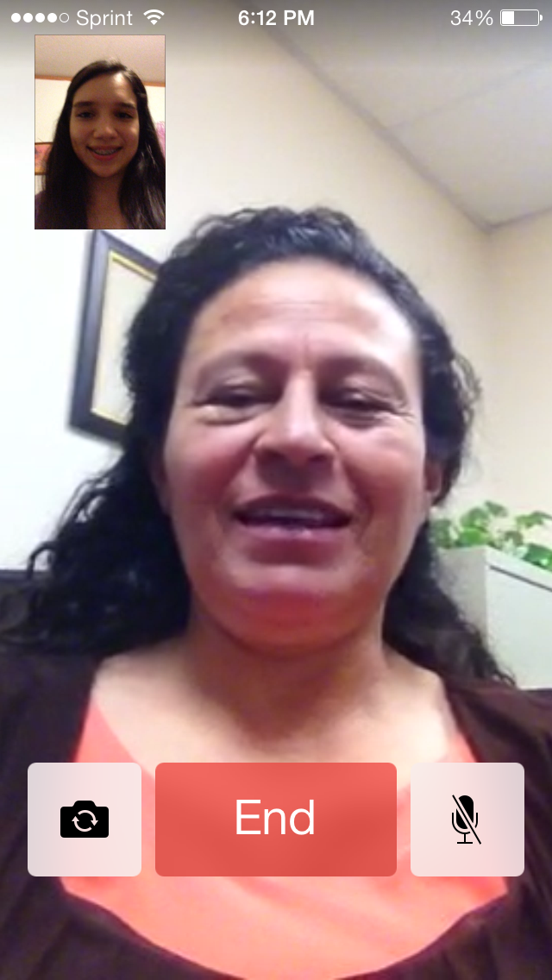
Mentor
Angeles Martinez, beauty consultant and representative of Mary Kay

Slide 11
Challenges and Successes
Challenges
Successes
Finding a mentor
Researching natural beauty tips
Teaching in Spanish
The women in my classes really seemed to enjoy them and asked a lot of questions.
Plenty of volunteers

Slide 12
What I learned…

Slide 13
Thank you for your time.
Do you have any questions?

